Slide 1
Grid storm
BY: JESTEN AUGER
DERICK ESGUERRA
LORENZO PICKEN

Slide 2
Tagline
WHERE LIGHT IS YOUR WEAPON, AND THE GRID IS THE BATTLEFIELD

Slide 3
About the game
GENRE: ACTION, FPS, MULTIPLAYER, BATTLE ROYAL
16-PLAYER MULTIPLAYER
FIRST PLAYER TO WIN 3 TIMES IN A ROW WINS.

Slide 4
core GAMEPLAYE
PLAYER ABILITIES:
2 DASH FOR MOBILITY
FAST MOVEMENT SPEED
START WITH BASIC PISTOL, UPGRADED TROUGH LOOT
GAMEPLAY LOOP:
ENTER ARENA → COLLECT LOOT & POWERUPS → FIGHT TO SURVIVE →
WIN ROUNDS → FIRST TO 3 WINS

Slide 5
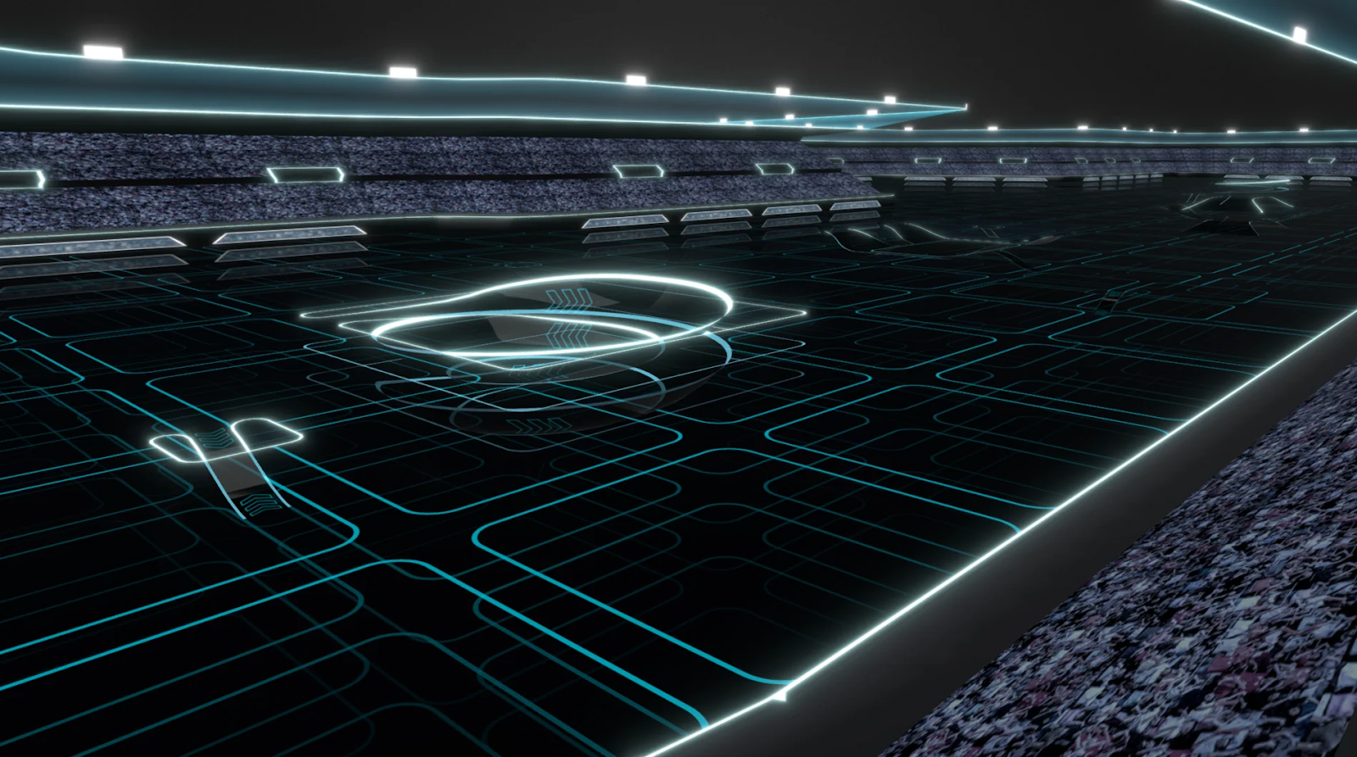
inspirations

Slide 6
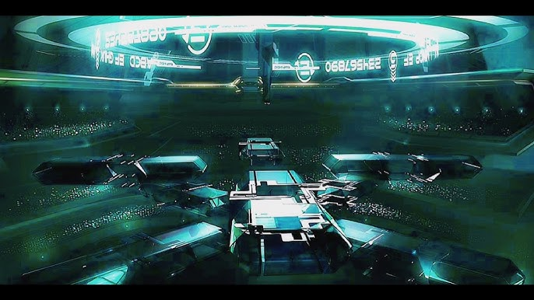

Slide 7
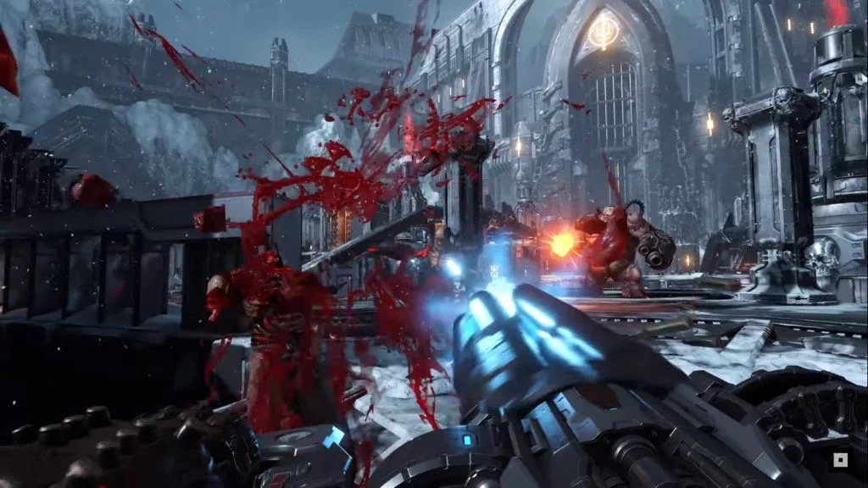

Slide 8
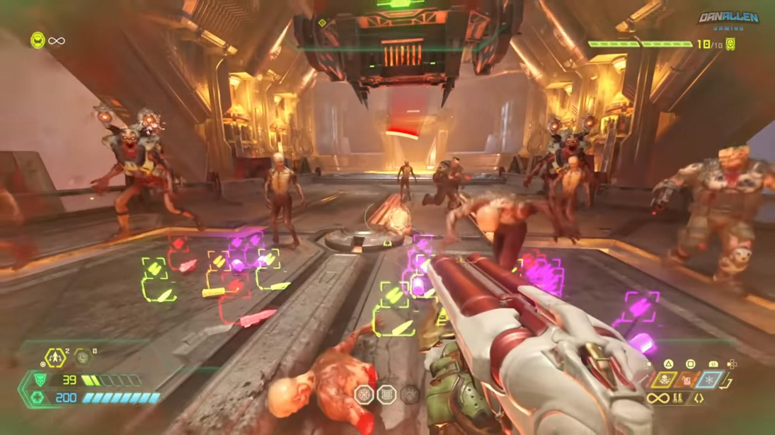

Slide 9
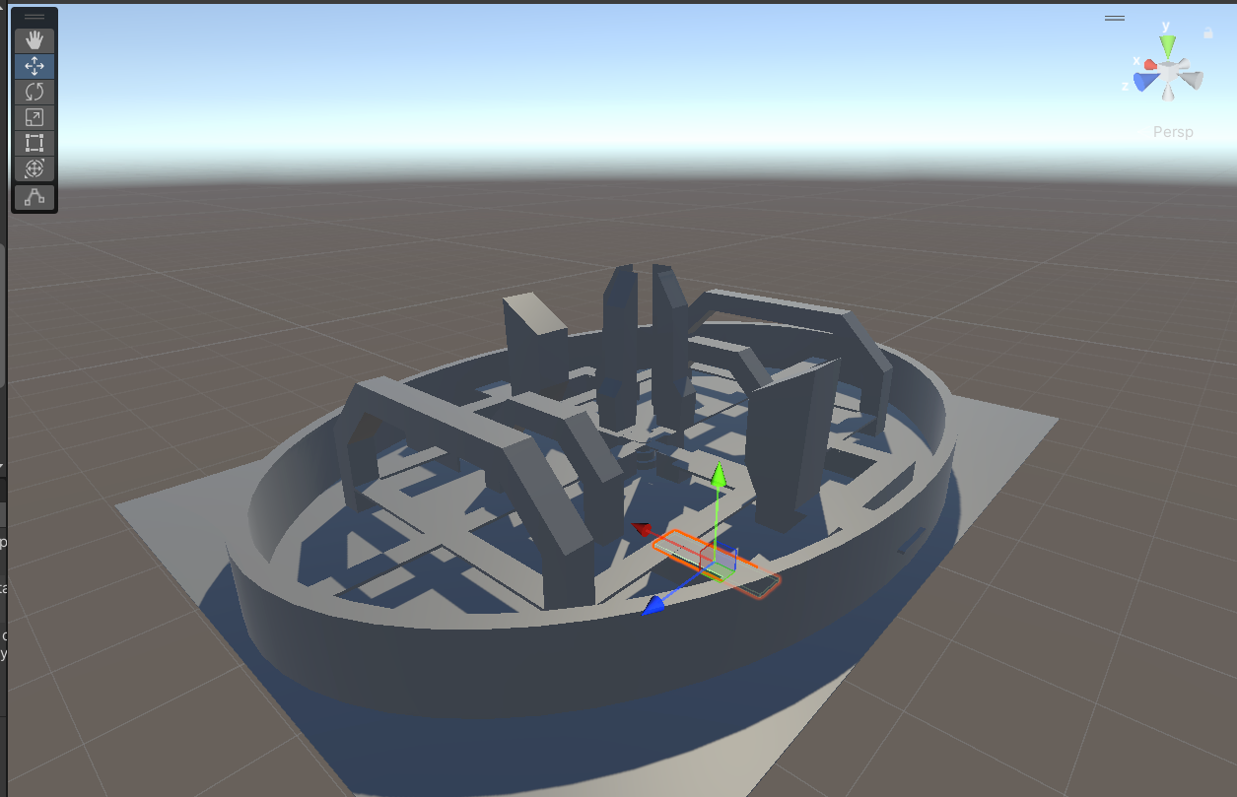
DESIGN

Slide 10
Delivery 1
Lorenzo task:
Multiplayer Capabilities (2/12)
Player Controls (2/17)
Derick task:
Power Ups (2/12)
Weapon Randomizer (2/17)
Jesten task:
Design Map (2/17)
SFX (2/24)
Health System (3/3)

Slide 11
Delivery 2:
Lorenzo task:
Synching player data (3/12)
Gunplay (3/19)
Derick task:
Damage System (3/12)
Scoreboard (3/19)
Jesten task:
Design Weapon (3/19)
Polish Game arena (3/26)

